Slide 1
Ninth Circuit Immigration Cases to Watch
Prof. Michael Kagan
UNLV Boyd School of Law

Slide 2
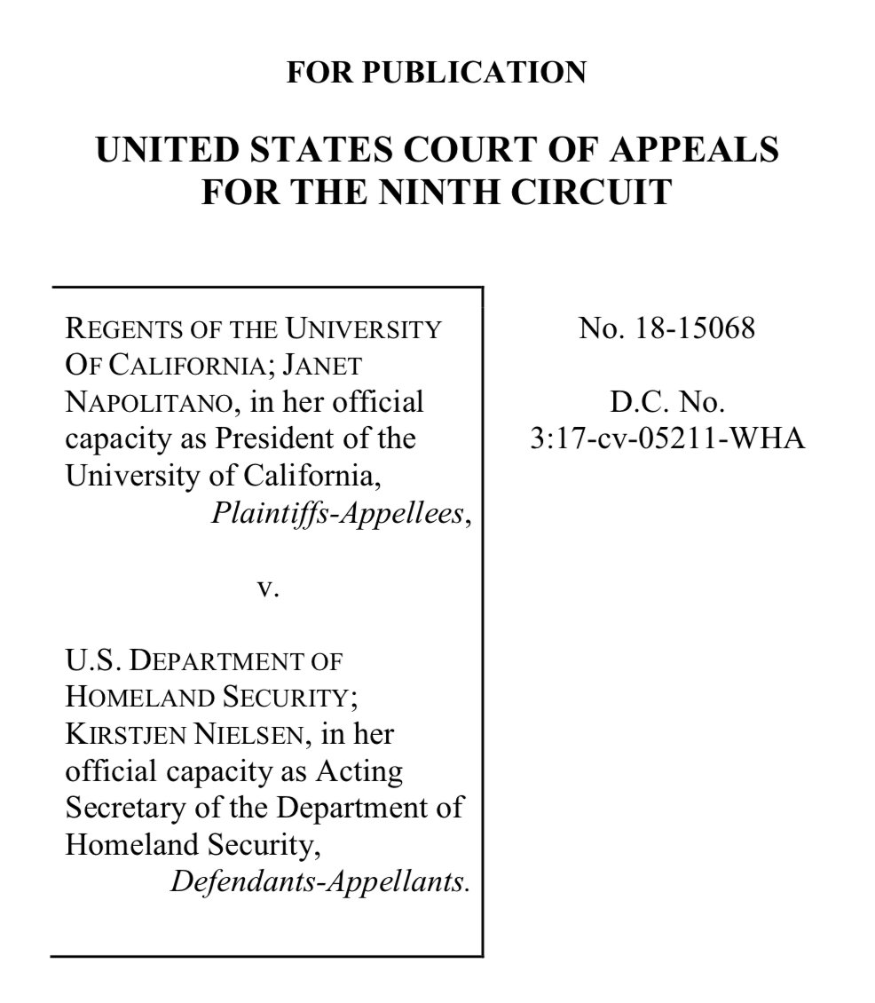
The DACA Case

Slide 3
The DACA Case (Deferred Action for Childhood Arrivals)
Is a change in deferred action policy reviewable?
Was the rescission of DACA arbitrary, capricious or an abusive of discretion?
Was DACA legal to begin with?
Even if it was legal, can the government cite doubts about its legality as a reason to rescind?

Slide 4
The DACA Case – Pending Cert. Petitions
DHS v. Regents (CA9)
Trump v. NAACP (D.D.C.)
Nielsen v. Vidal (CA2)
All relisted since Jan 11.

Slide 5
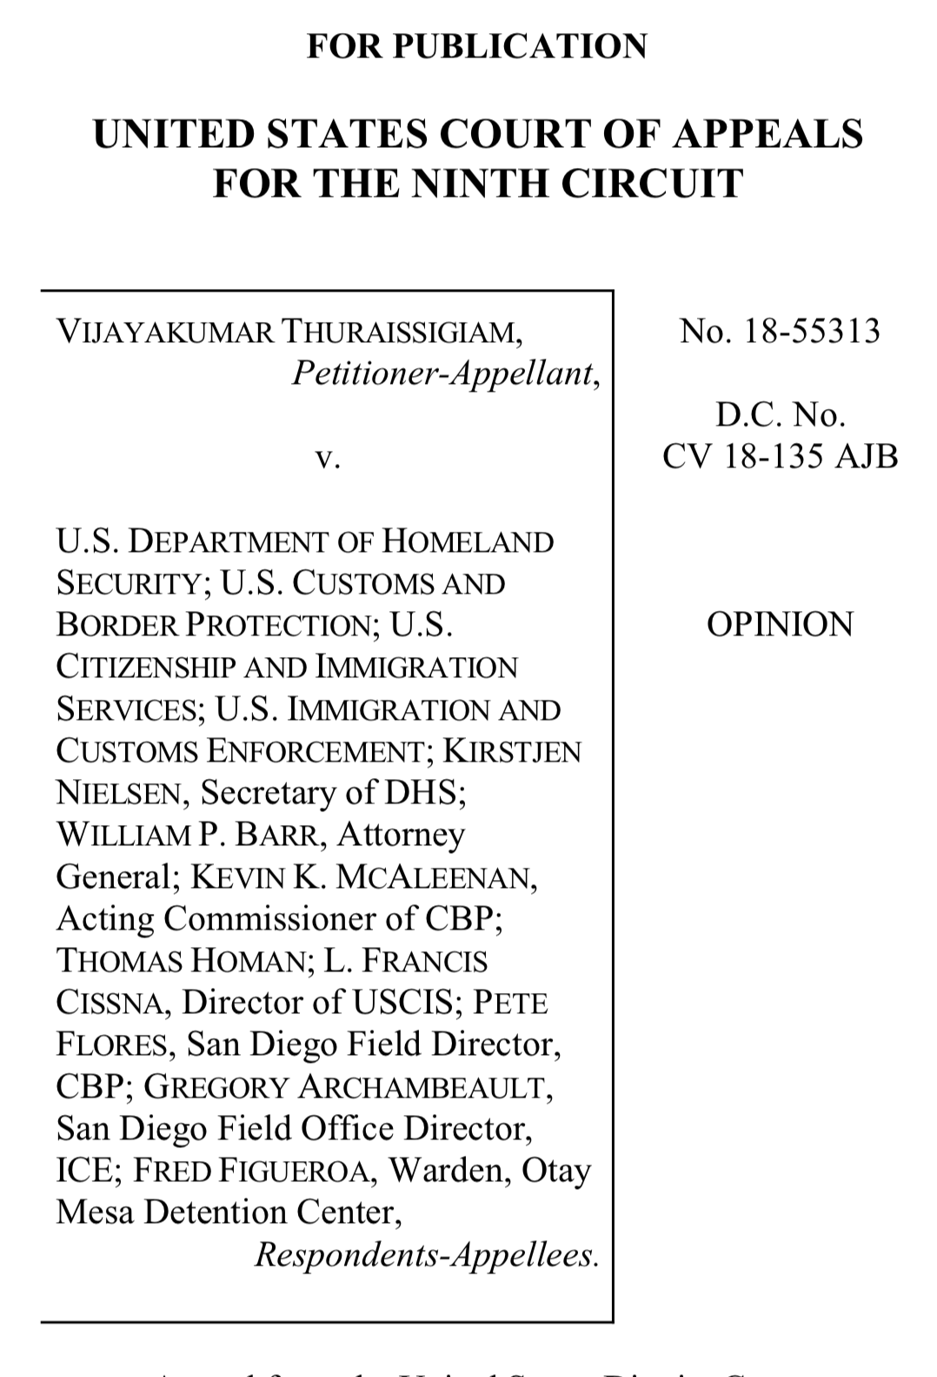
The Expedited Removal
Case

Slide 6
The Expedited Removal Case
(decided March 7, 2019)
Can a person denied asylum at the border seek review through habeas?
Holding: Congress violated the Suspension Clause by eliminating judicial review for asylum-seekers rejected in the credible fear process.

Slide 7
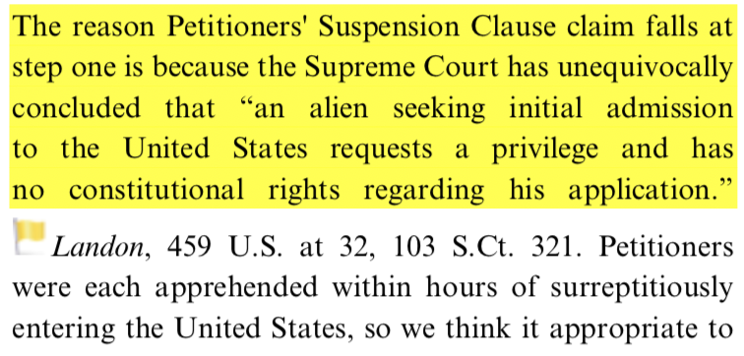
The Expedited Removal Case – Circuit Split
Castro v. DHS, 835 F.3d 422 (3d Cir. 2016)
Rejected suspension clause argument based on plenary power doctrine, not Boumediene.

