Slide 1

Effective Briefing and
Oral Argument

Slide 2
Effective Writing
Value of Introductions
A Picture is Worth a 1000 Words
Summary of Argument: Concise or Full?
Standards of Review: Omnibus or Section-by-section?
Writing for Technology

Slide 3
Oral Advocacy
Panel Preparation
Does it matter?
Tips of the trade

Slide 4
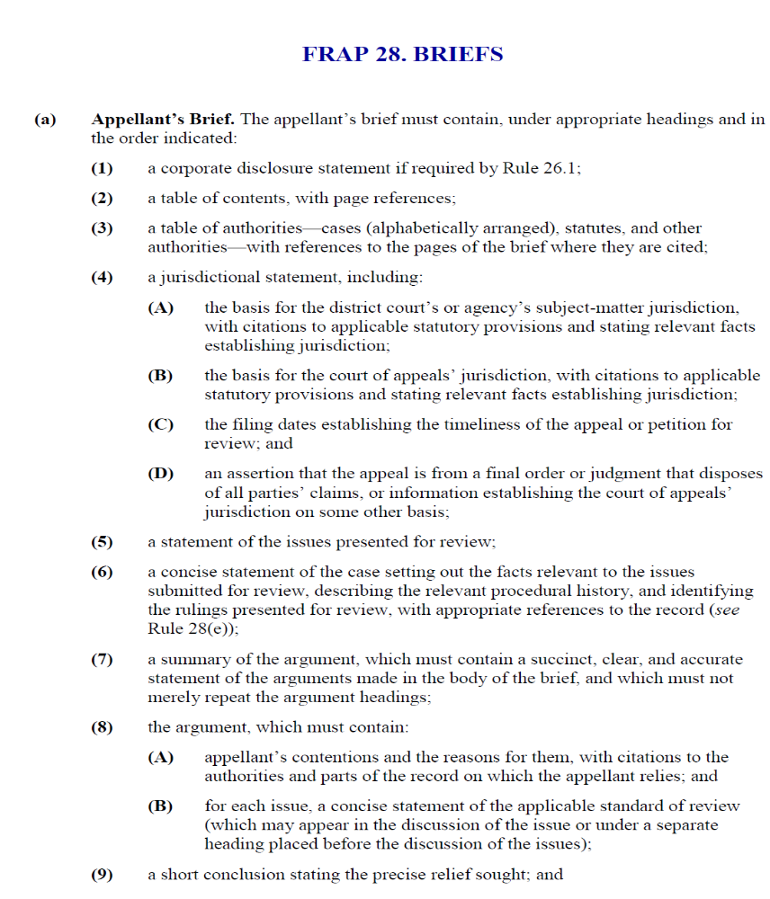
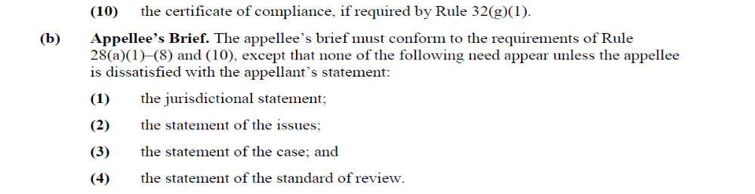
Introduction?

Slide 5
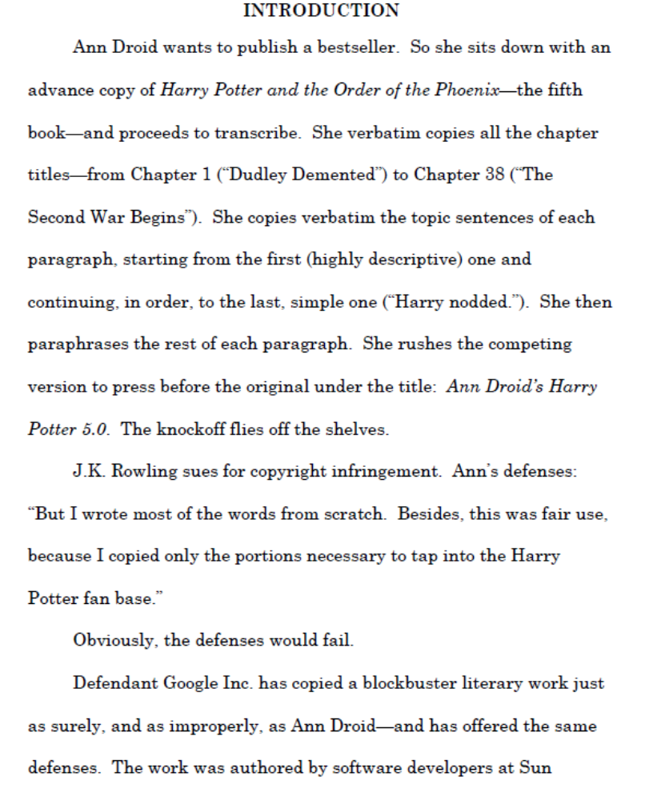
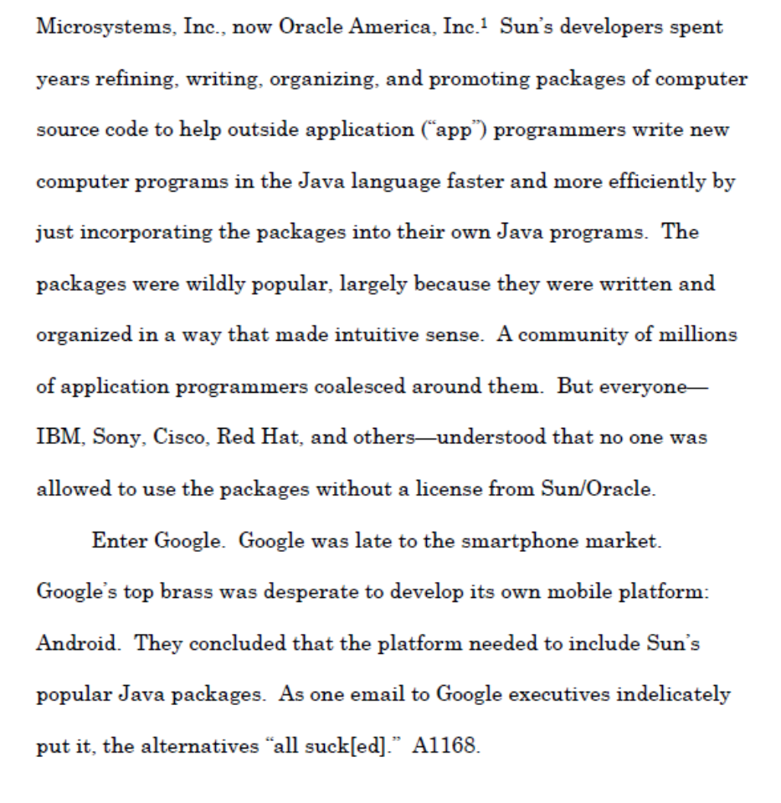

Slide 6
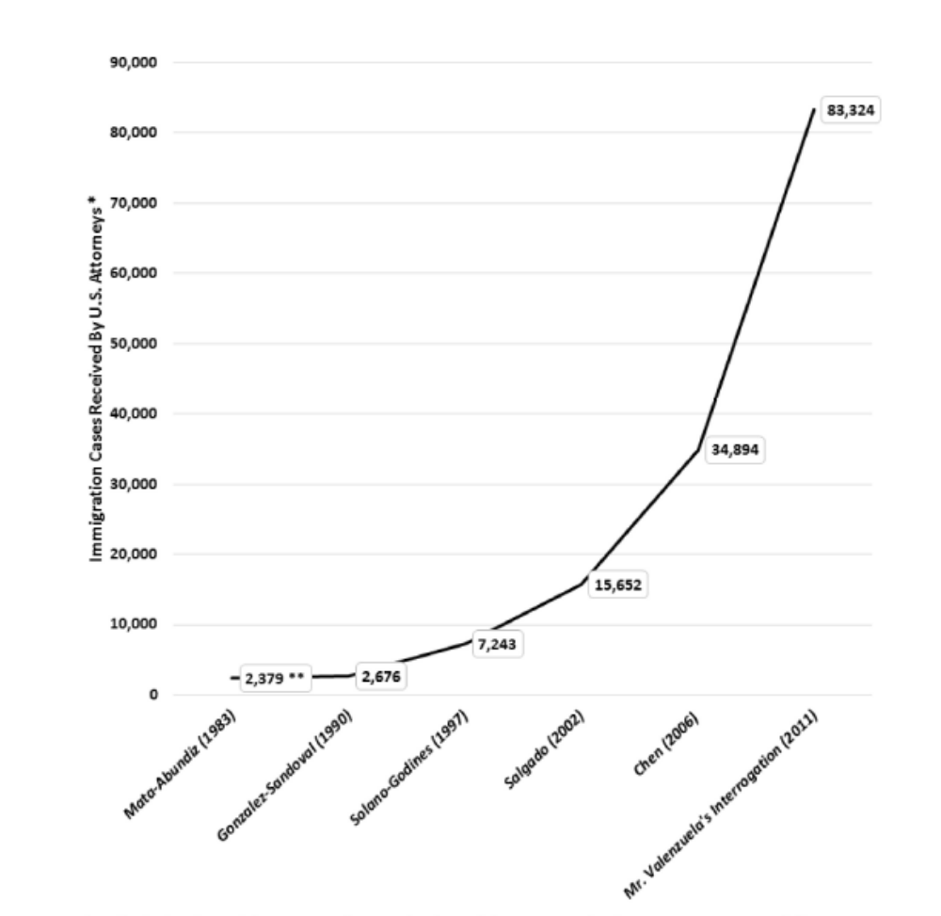
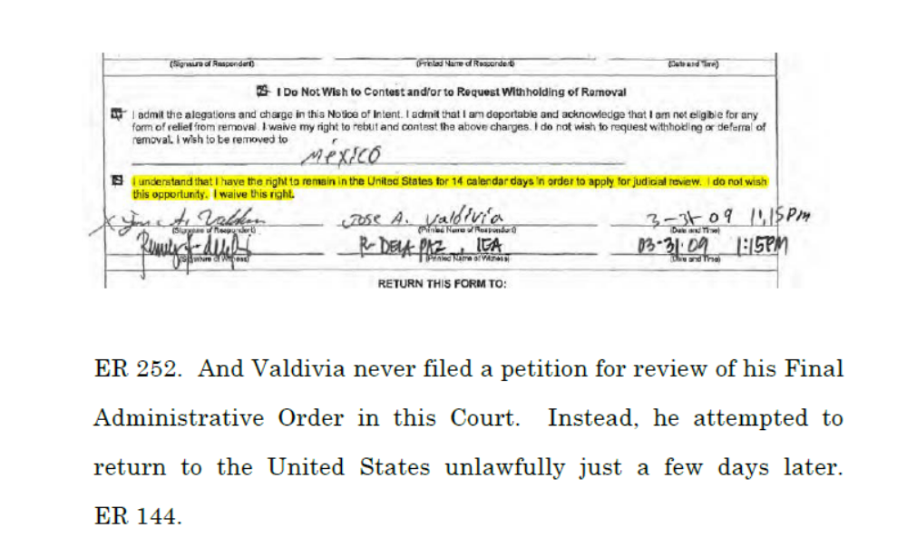
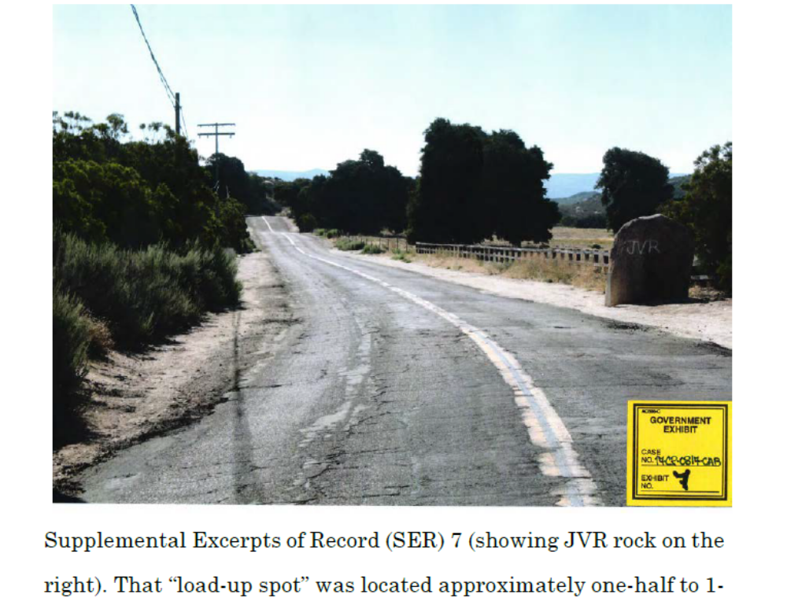
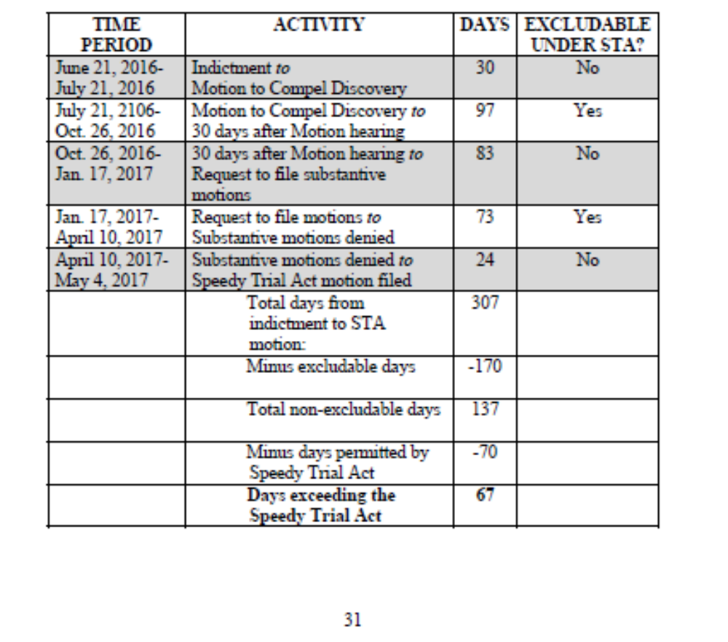
Charts/Diagrams/Timelines

Slide 7

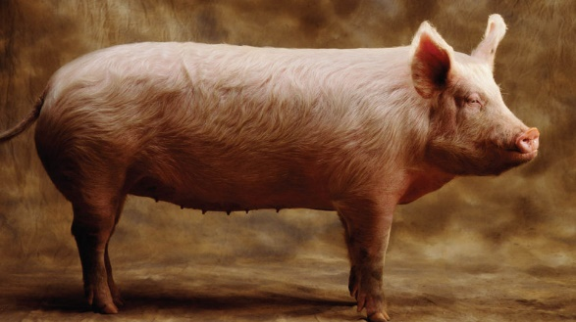
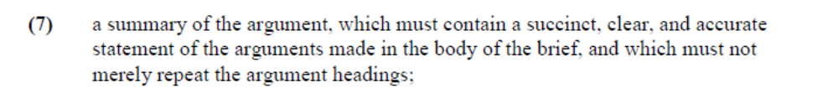
Summary of Argument
vs.

Slide 8
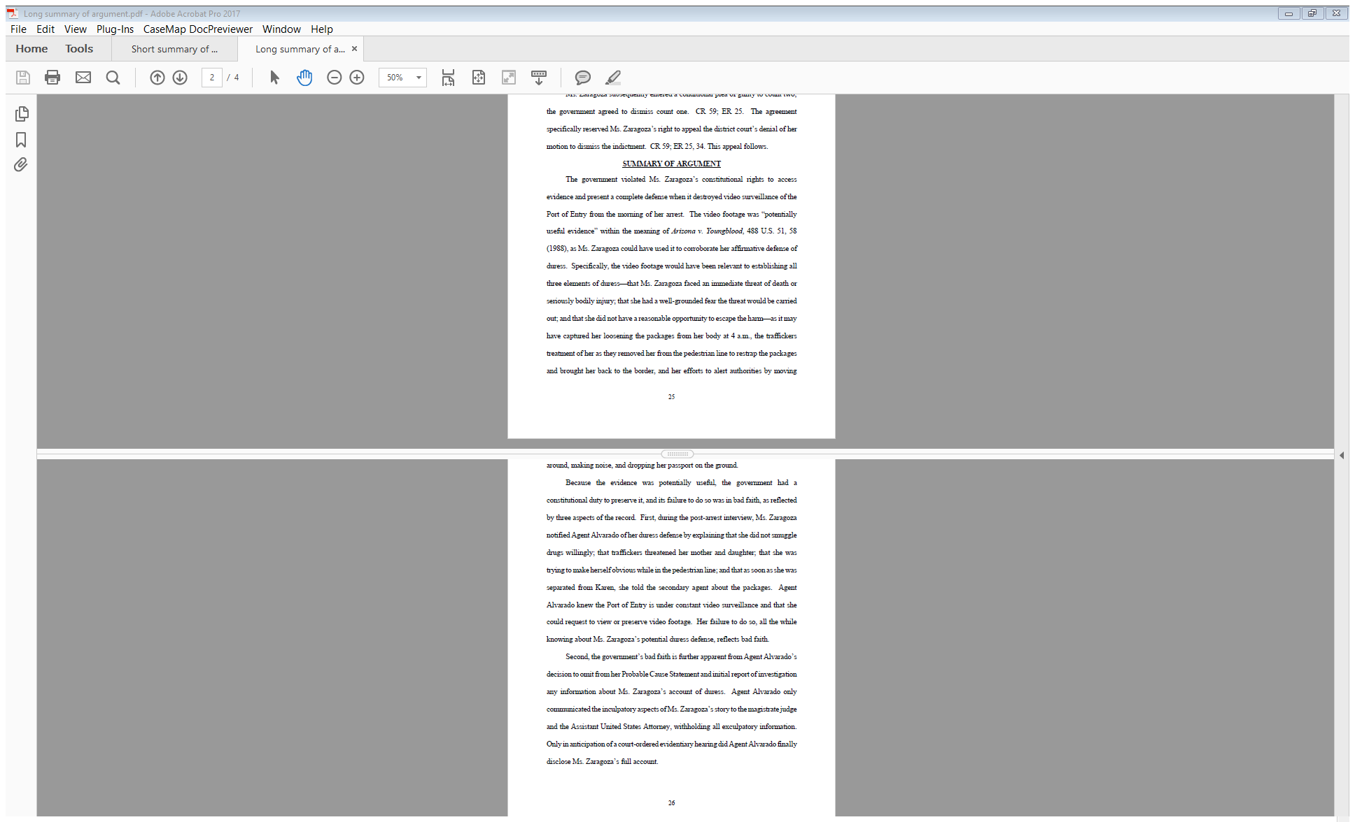
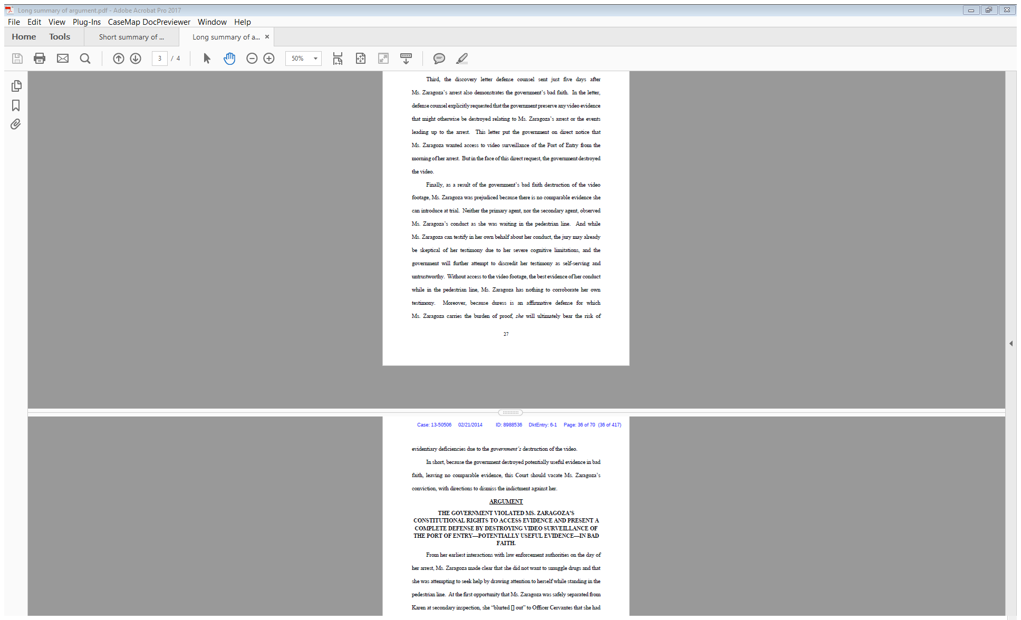
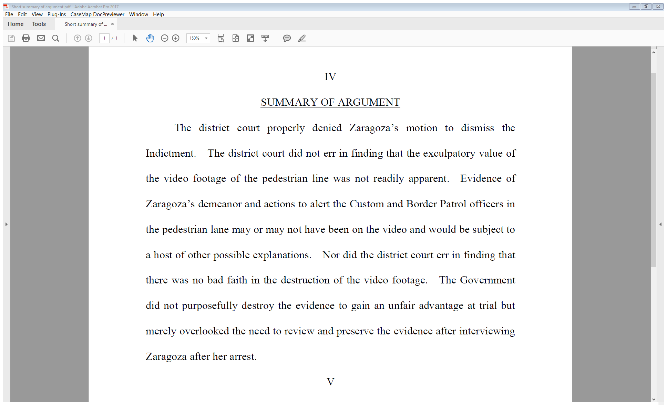
Summary of Argument

Slide 9
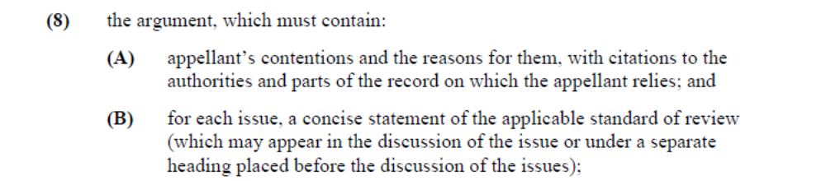
Standards of Review

Slide 10
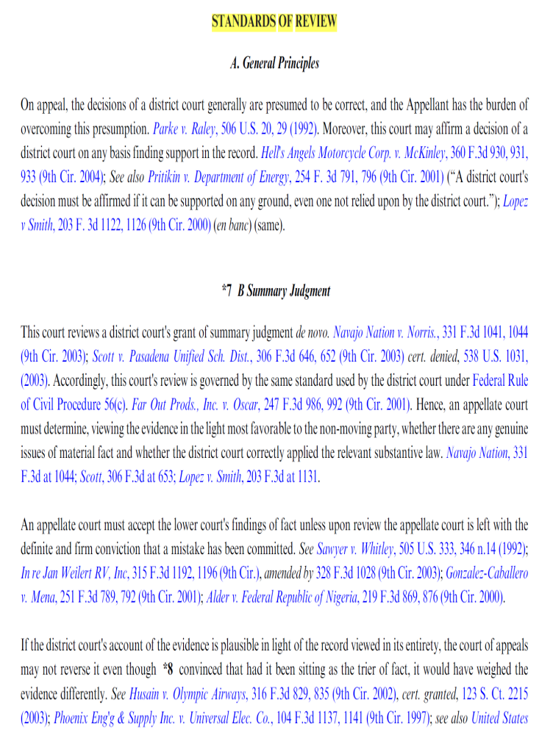
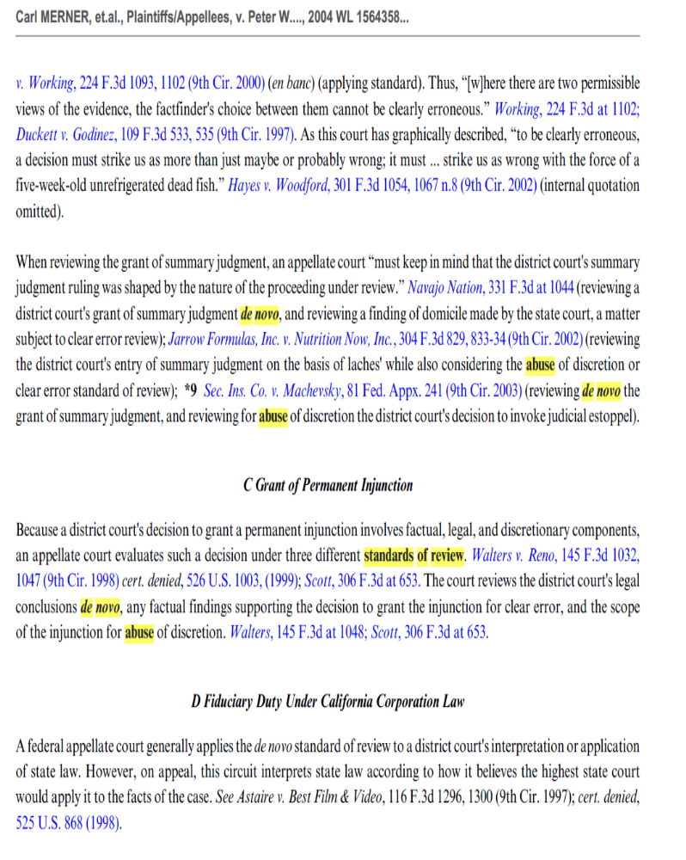
Standards of Review

Slide 11

Technology

Slide 12
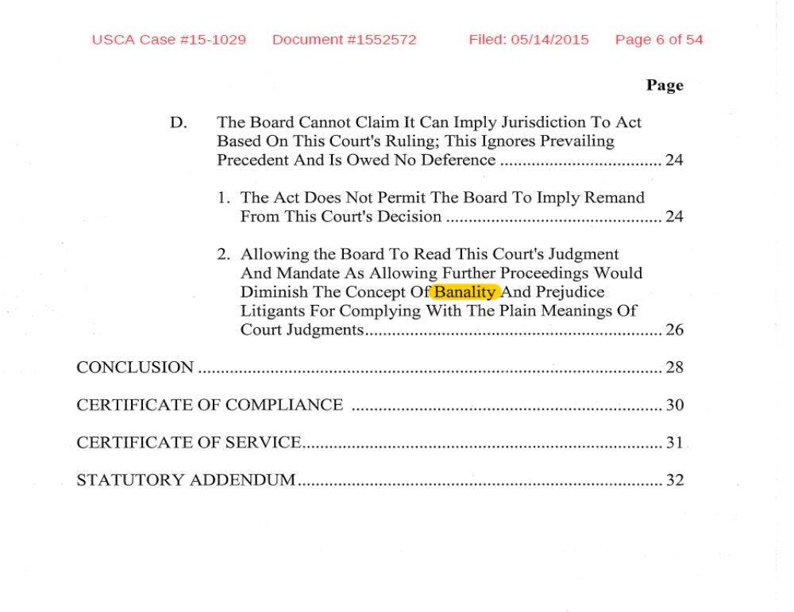
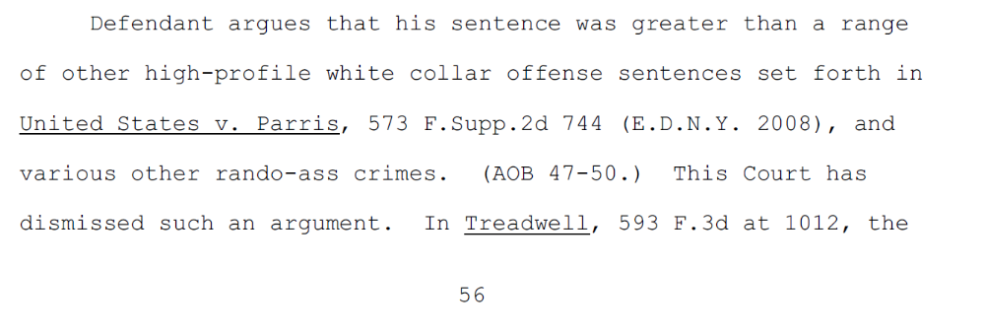

Editing

Slide 13

Oral Argument

