Slide 1
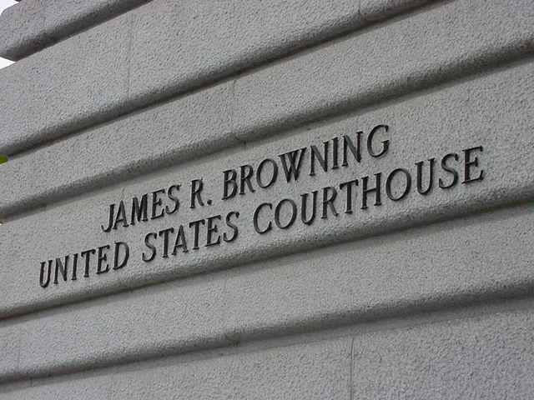
The Ninth Circuit Court of Appeals

Slide 2
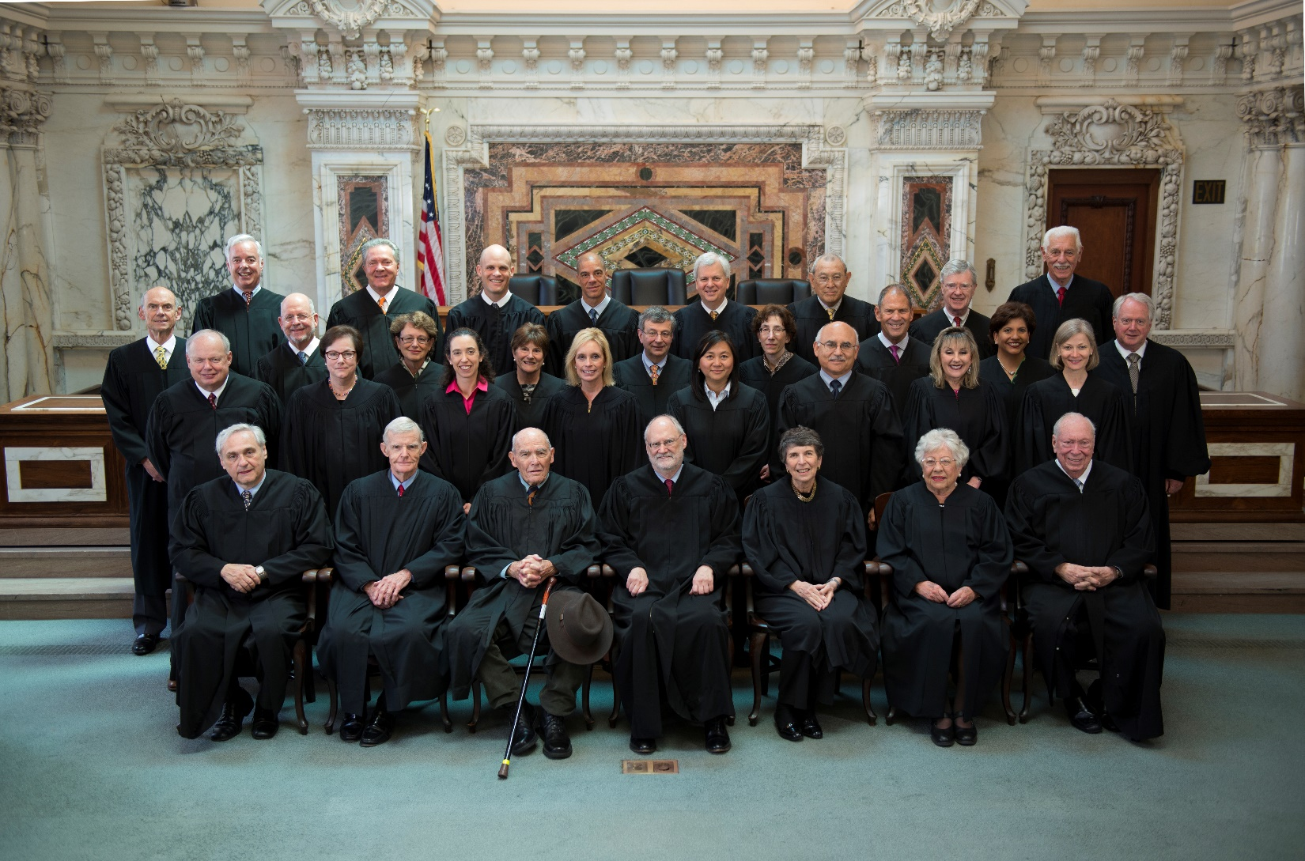
Court 2014

Slide 3
Caseload as of June 30, 2015
Notes:
So we are the biggest; the 1st is the smallest. The 5th is the next closest to us.

Slide 4
Where Do The Come From?
Notes:
The Board of Immigration Appeals is our biggest customer, followed by the Central District – with the Northern and Eastern districts right behind and Arizona definitely in the mix.

Slide 5
Notes:
An illustration of the different types of cases we get. 30% of our cases are agency cases and of these, most are immigration cases. About 23% of our cases are prisoner cases.

Slide 6
Median Processing Times NOA - Decision

Slide 7
Notes:
50% of our cases filed pro se. The good news is that you won’t see them – unless we appoint pro bono counsel and then, you cannot submit them.

Slide 8
Notes:
And then if you look at the cases we actually terminate on the merits, after the completion of briefing, we are submitting more than 5000 of those on the briefs, and only 1492 are getting oral argument.
*less than 23 % of our total terminations were argued, 77 %were submitted on the briefs and 41% were procedurally terminated.

Slide 9
Notes:
In terms of submissions on the briefs – a total of 5247 cases were submitted for the 12 months ending June 30, 2015. Of these 2738 were submitted by argument panel and 2510 by screening panels

Slide 11
Ninth Circuit Arguments

Slide 12
Notes:
In terms of the actual decisions – the overwhelming number of cases are decided in a memorandum dispostition. About 476 opinions

Slide 13
Notes:
We would be even further behind than we are without the work of our very active senior judges. 27% of our merits terminations involved a senior or visiting judge. We do use quite a few visiting judges

Slide 14
Notes:
17% US civil cases
19% private civil
9% agency

Slide 15
Notes:
Here are the raw numbers for 2015 (to date): PFREBs = 555; Ballots = 23; Yes Votes = 12
If you want the statistics based on a full year, here are the raw numbers for 2014: PFREBs = 778; Ballots = 31; Yes Votes = 18

Slide 16
Notes:
Depending on how you look at it – a 67% reversal rate (compared to a 91% reversal last Term)

